Slide 1
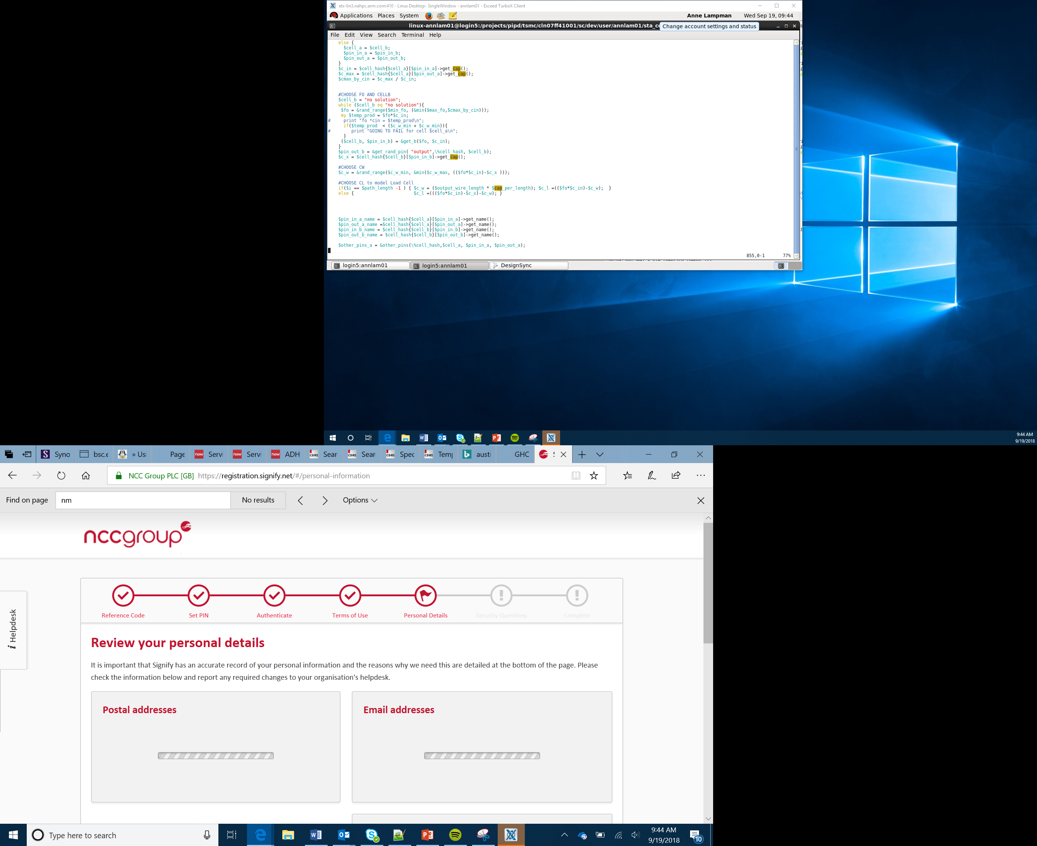

Bit:Bot Race Car Project
One Lap test
Lesson 12

Slide 2
Objectives
Apply what you have learned to make the car complete one lap autonomously
Complete one safe lap as quickly as possible
Create a section plan for each race section
Combine to create a complete algorithm for the racetrack
Notes:
Remind students of the overall project aim

Slide 3
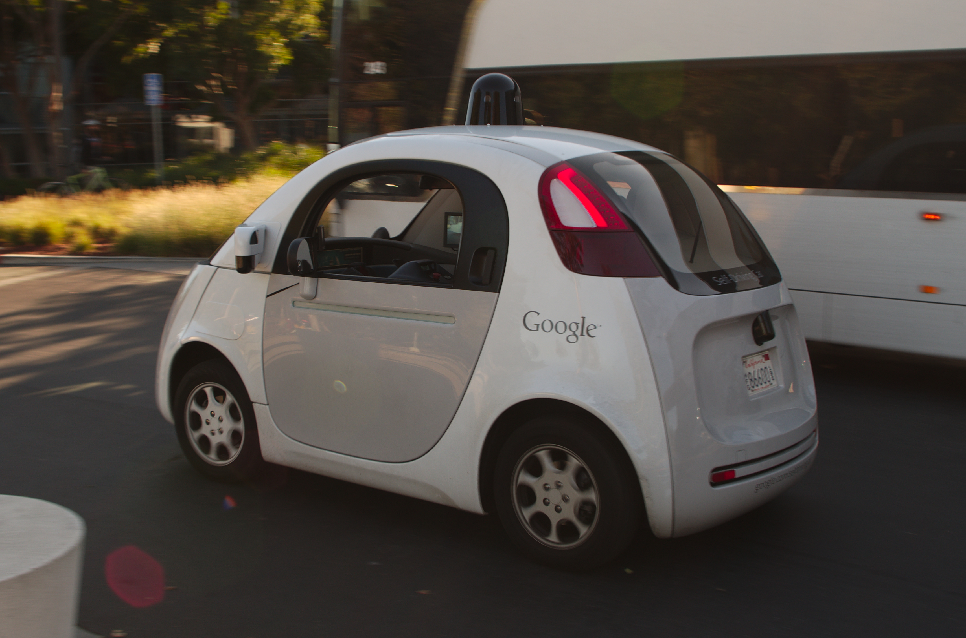
Self-driving Vehicles
Companies like Waymo and Google have been developing self-driving (or autonomous) cars for several years
Self-driving cars could: reduce the stress of driving, reduce accidents and improve traffic flow in major cities
Autonomous cars combine a variety of sensors to understand their surroundings, such as radar, computer vision, sonar and GPS
By utilising sensors and accurate mapping the self-driving car could pick you up from your home and deliver you to you location
Notes:
Reference https://en.wikipedia.org/wiki/Waymo
https://en.wikipedia.org/wiki/Self-driving_car
Introduce the development of self-driving cars, get Learners to talk about how they feel about these. Would they trust them? What about taxi drivers etc would there be an ethical impact to their common use

Slide 4
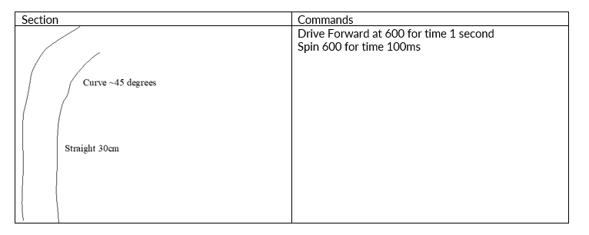
Algorithm Plan
Apply what you’ve learned from the previous lessons
Look at the track and break it down into small sections (decomposition)
Consider how far / fast the car travels with different settings
Consider the angles you will need to get round the bends and curves
Expect the get it wrong – fail early, fail often
Notes:
Discuss how Learners can plan out their algorithm and the importance of accurate measurements
Relate this to decomposition – the breaking down of complex problems into easy to solve chunks

